Slide 1
IBM University Engagement Project Submission
“Exploring the Power of Agentic AI with IBM Granite”

Slide 2

Project Tile – AI Grant And Funding Finder For Startups
Domain of Project – Artificial Intelligence / Technology
Student Name | Recent Passport Photo | Email ID | Mobile number [WhatsApp]
Aarya Manohar Gujar |  | aaryagujar@acpce.ac.in | 8459458738

Slide 3
Problem Statement -
Problem Statement : AI Grant And Funding Finder For Startups
The Challenge : Developing an AI-based Grant and Funding Finder for startups poses several challenges. Funding opportunities are spread across multiple platforms, each with different formats, languages, and update frequencies, making data collection and real-time aggregation complex. Extracting relevant details like eligibility, deadlines, and submission requirements from unstructured content demands robust natural language processing. Personalizing results based on a startup's stage, domain, and location adds another layer of complexity. Moreover, automatically generating tailored proposals or application drafts must strike a balance between accuracy and creativity, often requiring human validation. Finally, ensuring the agent respects legal boundaries and submission rules—especially for confidential or restricted portals—remains critical.
Objective: Build an AI-powered platform that aggregates funding opportunities and helps startups identify relevant grants. The solution should:
• Aggregate grant information from curated records, RSS feeds, and public websites.
• Extract and summarize eligibility, deadlines, and key requirements.
• Match grants to a startup’s stage, domain, location, and profile.
• Generate structured, tailored proposal drafts for human review.
• Respect public-data access rules and require verification before submission.

Slide 4
Proposed Solution -
Proposed Solution: AI Grant and Funding Finder for Startups
The proposed solution is a web-based AI funding assistant built with a Flask backend, a lightweight HTML/CSS/JavaScript frontend, IBM Granite through watsonx.ai, and IBM Cloud Lite configuration. It brings grant discovery, personalised matching, grant summarisation, and proposal drafting into one workflow.
A grant aggregator collects opportunities from a curated dataset, public RSS feeds, and public web sources. The collected records are cached in JSON to reduce repeated fetching. Users can browse and filter grants by keyword, domain, startup stage, location, and funding type.
The matching engine combines TF-IDF cosine similarity and rule-based profile matching with IBM Granite AI re-ranking. The proposal generator uses Granite prompts to create structured application drafts, with an offline template fallback when AI credentials are unavailable.
Key modules:
• Grant Aggregator – collects, parses, and caches public funding opportunities.
• Matching Engine – ranks opportunities against a startup profile.
• Granite AI Service – summarizes grant text and supports AI matching.
• Proposal Generator – prepares editable proposal drafts.
• Flask REST API + Web UI – connects users to search, matching, and drafting features.

Slide 5
Technology Used
IBM Bob platform - For designing and orchestrating multi-agent workflows visually
IBM Grainte model - Supports grant summarisation, eligibility extraction, AI-based matching, and proposal generation.
IBM Cloud Lite - IBM cloud environment used for service configuration and secure credential-based integration. API credentials and project settings are supplied through environment variables.
IBM Watson Natural Language Understanding (NLU) – Used for entity extraction and keyword analysis from grant content.
IBM Watsonx.ai - Provides the foundation-model inference endpoint used to access IBM Granite.
Public Web Sources – Stores collected grant data and supports multi-source aggregation.

Slide 6
Application component Used -
Web User Interface – Allows startup founders to browse opportunities, enter their startup profile, request AI matches, and draft proposals.
Flask Backend – Receives frontend requests and routes them to the relevant grant and AI services.
IBM Granite Model – IBM Granite 13B Instruct via watsonx.ai supports grant summarization, eligibility extraction, personalized re-ranking, and proposal drafting.
Grant Aggregator – Combines curated grant records with RSS parsing and public-source scraping; stores results in a JSON cache.
Matching Engine – Uses TF-IDF cosine similarity, stage/domain/location rules, and Granite AI re-ranking to prioritize relevant grants.
Proposal Generator – Produces structured proposal sections using Granite prompts, with a template fallback for offline demonstrations

Slide 7
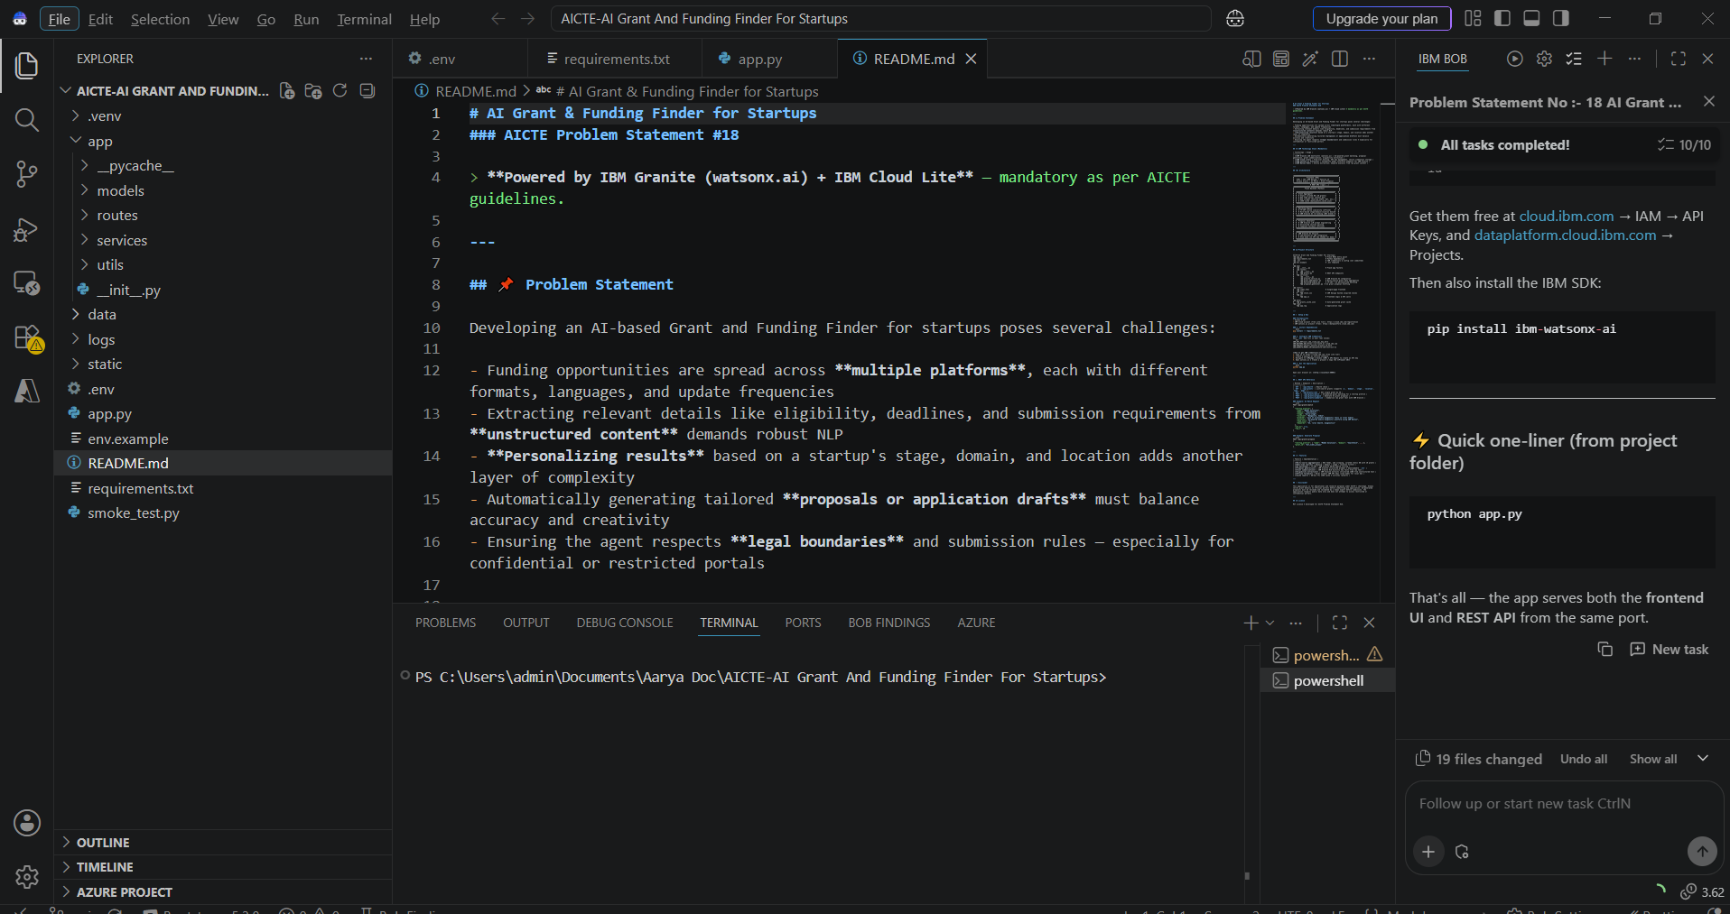
Required Files created using IBM bob -
app.py
requirements.txt
.env
index.html
fonts.css

Slide 8
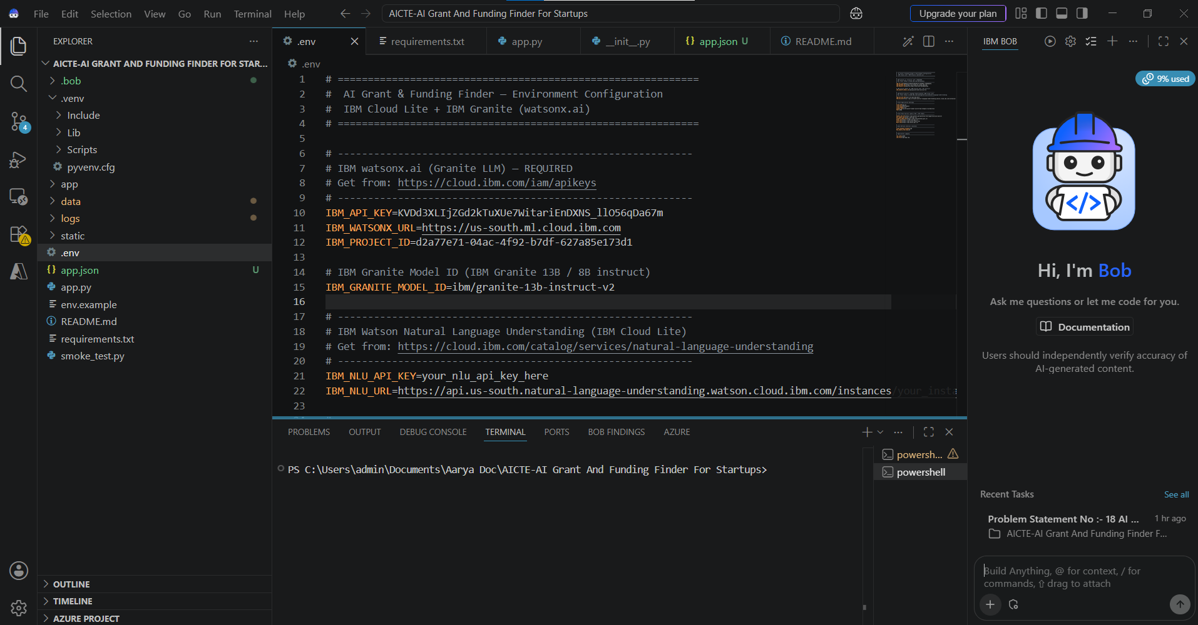

Slide 9
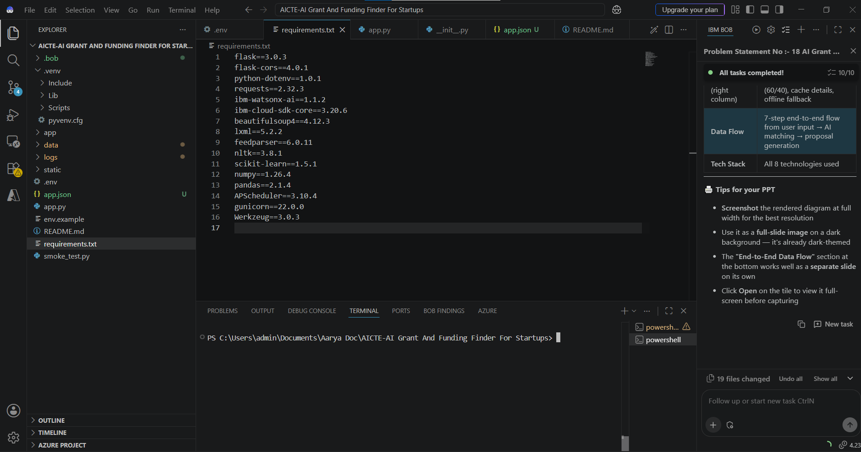

Slide 10
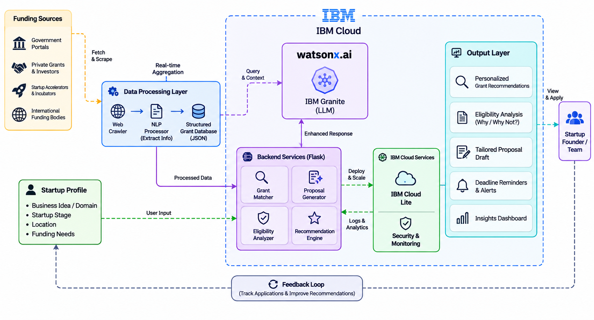
Architecture blueprint

Slide 11
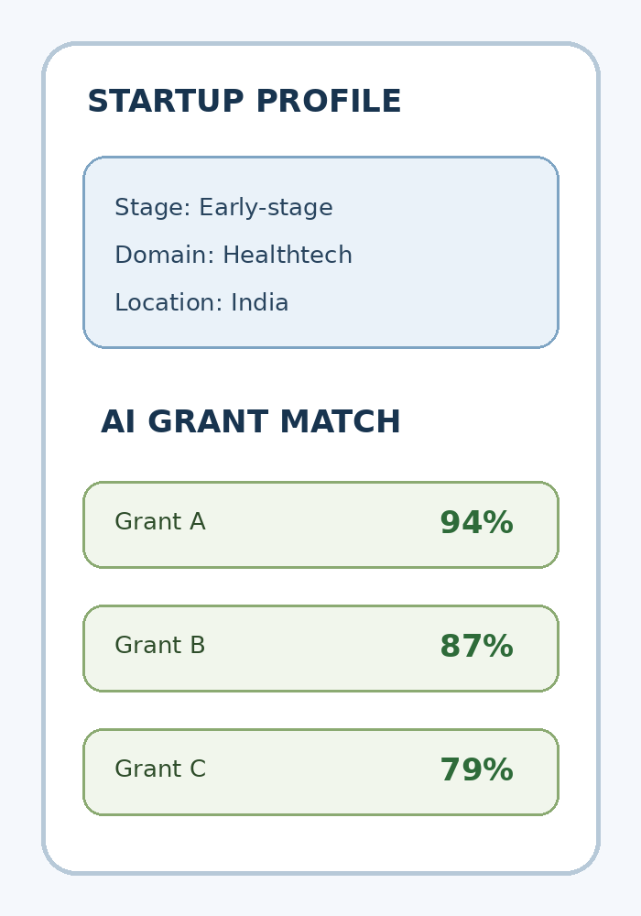
Role of Agentic AI in the solution
Role of IBM Granite AI in the Funding Finder
IBM Granite AI enhances the funding discovery workflow by providing language understanding and content generation capabilities. It summarizes public grant descriptions into clear and concise information, helping startup founders understand eligibility criteria, funding requirements, and application conditions. It also improves personalized grant matching by re-ranking potential opportunities based on the startup's profile, combining AI-based analysis with TF-IDF similarity and rule-based matching for startup stage, domain, and location. Additionally, IBM Granite AI generates editable proposal drafts using information from the selected grant and startup profile, which can be reviewed and validated by users before submission. The Flask application coordinates the grant aggregator, matching engine, IBM Granite AI service, and proposal generator through backend modules and REST API endpoints. The system is designed for informational assistance only and does not automatically submit applications or access confidential or restricted portals. Users must verify all official grant details and requirements before submitting an application.

Slide 12
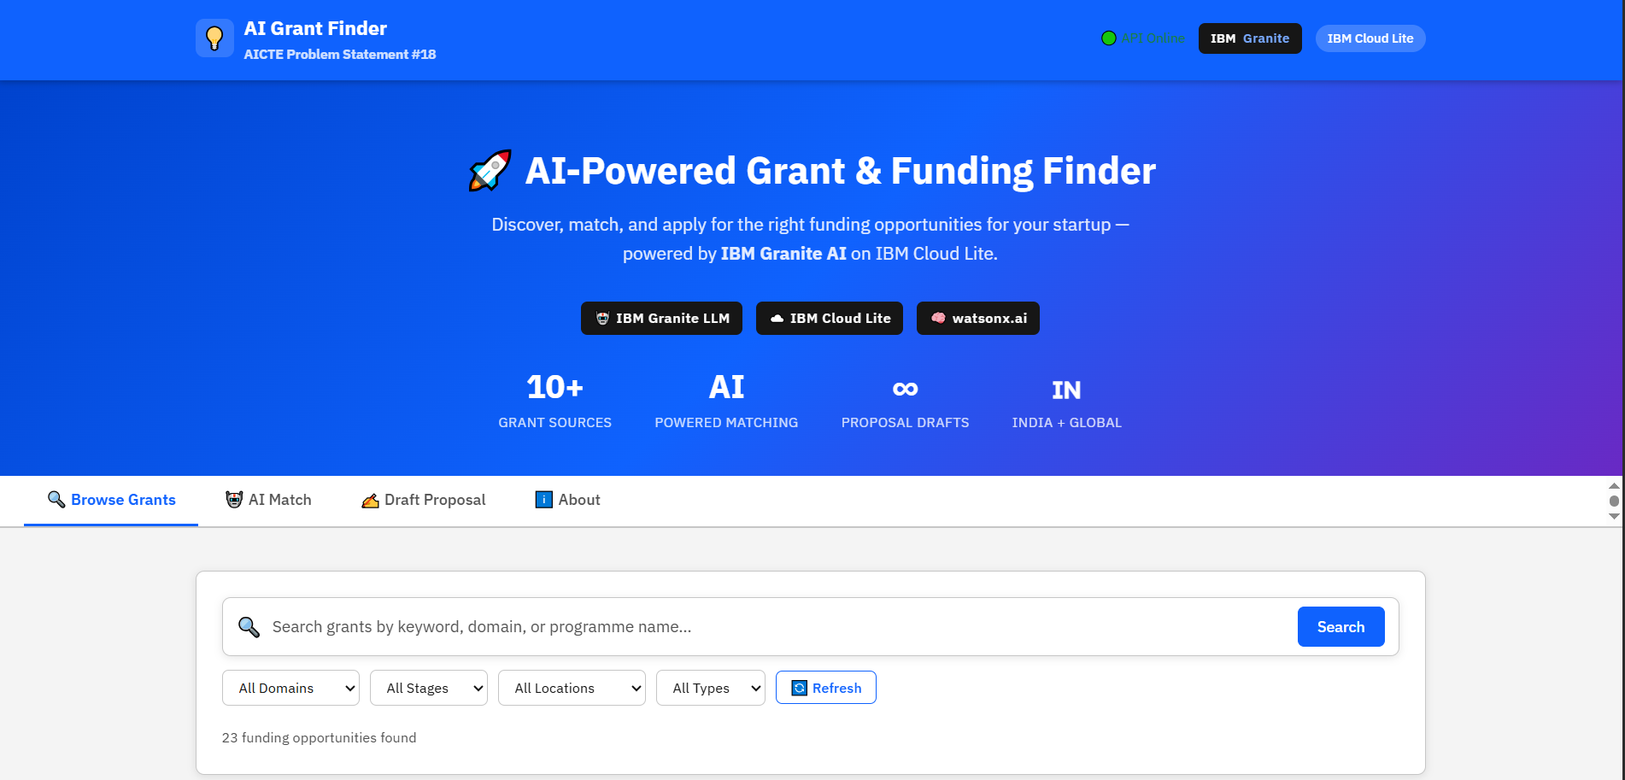
Project Output Screenshots
·
·
·

Slide 13
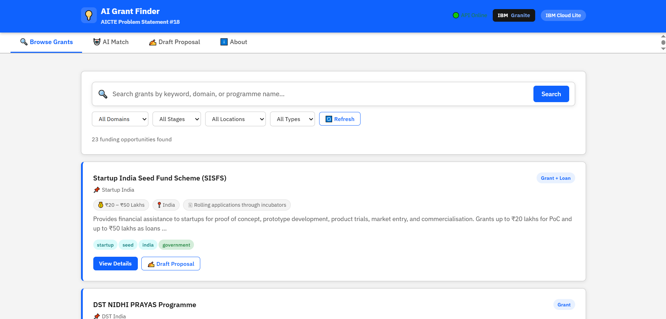

Slide 14
Novelty and Uniqueness
The AI Grant and Funding Finder combines multi-source discovery, hybrid matching, IBM Granite intelligence, and proposal drafting in one startup-focused platform.
Multi-Source Aggregation – Brings together curated grant records, RSS feeds, and public web sources, with a JSON cache to reduce repeated retrieval.
Hybrid AI Matching – Combines TF-IDF cosine similarity, rule-based stage/domain/location scoring, and IBM Granite AI re-ranking for more relevant results.
Grant Intelligence – Uses Granite to summarize unstructured descriptions and extract eligibility information into a more usable format.
Tailored Proposal Drafting – Generates structured proposal sections based on the startup profile and selected grant, with an offline template fallback.
Practical API Design – Exposes separate endpoints for grant search, individual grant details, matching, proposal generation, and summarization.
Responsible by Design – Uses public grant information and keeps a human in control of final verification and submission.

Slide 15
Git Hub Link
Please create public github repository (Enable Add README button while creating repository) with format –
Please test and Paste the working Github URL –
https://github.com/Aarya-Gujar/AI-Grant-And-Funding-Finder-For-Startups-Project
Make sure you have Uploaded following three files into your github repository
1) app.json file , 2) yourproblemstatement.pdf file 3) your projectpresntation.pptx file 4)any other files
·
·
·

Slide 16
Future Scope
1. Expanded Grant Sources & Scheduled Refresh – Add more government, incubator, university, and international funding sources. Introduce scheduled crawling, source health checks, and change detection so deadlines and program updates are refreshed more consistently.
2. Multilingual Grant Understanding – Extend language processing to support regional and international grant descriptions, while preserving original source links for verification.
3. Advanced Eligibility Reasoning – Add explainable eligibility checks that show which startup-profile fields match or fail each program requirement.
4. Founder Workspace & Deadline Alerts – Allow users to save grants, track application status, receive deadline reminders, and manage supporting documents.
5. Proposal Collaboration – Enable team review, version history, reusable organisation profiles, and export to common application formats.
6. Responsible Integrations – Add permission-based integrations with approved portals only; keep final submission under the founder’s control.
·
·
·

Slide 17
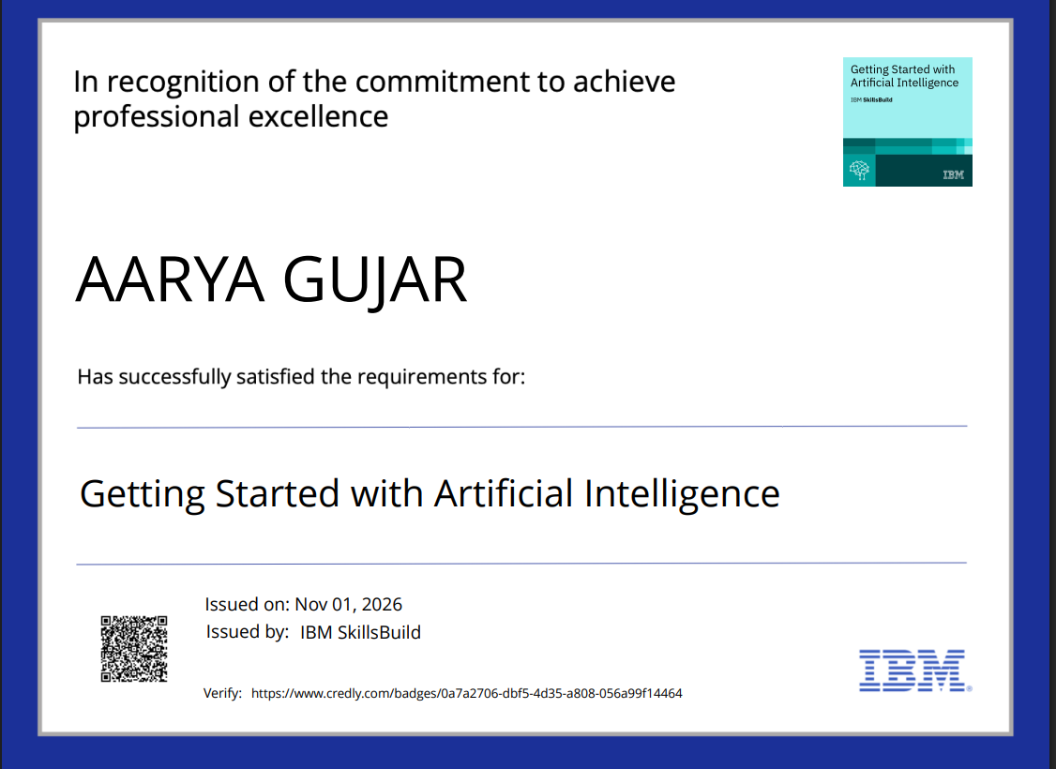
Certificates Earned:
Please add your credly certificate

Slide 18
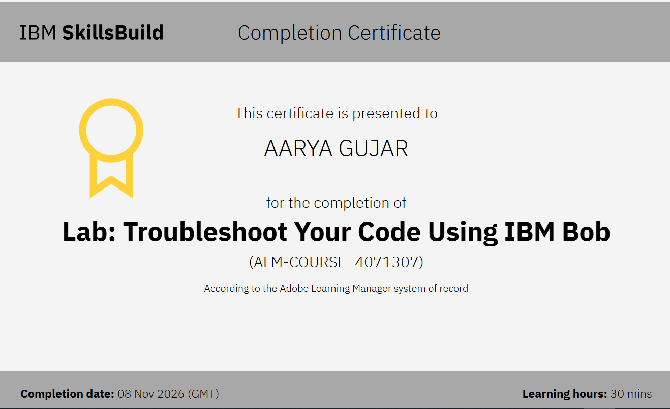
Certificates Earned:​
Add your IBM BOB Certificate

Slide 19


